Slide 1

A Joint Experimental Curriculum for Set and Graph Theory: The Algorithm Implementation for the Constructive Proof of Euler Graph
Yonghui Wu
Shanghai Key Laboratory of Intelligent Information Processing
School of Computer Science, Fudan University
yhwu@fudan.edu.cn

Slide 2
A Joint Experimental Curriculum for Set and Graph Theory: The Algorithm Implementation for the Constructive Proof of Euler Graph
This lecture is supported by Office of Global Partnerships (Key Projects Development Fund), Fudan University.

Slide 3
A Joint Experimental Curriculum for Set and Graph Theory: The Algorithm Implementation for the Constructive Proof of Euler Graph
Union-Find Sets :
Prerequisite
Euler Graph:
Graph modeling
Euler Theorem and Constructive Proof

Slide 4
Union-Find Sets
Union-find sets
π={S₁, S₂, …, S_{n}}, are disjoint sets, and S_{i} has an element rep[S_{i}], called the representative for S_{i}.

Slide 5
Three set operations for union-find sets
make_set(x):
For union-find sets π={S₁, S₂, …, S_{r}}, a set only containing one element {x} is added into π, and its representative rep[{x}]=x, where x is not in any S_{i}, 1≤i≤r.
join(x, y):
For union-find sets π={S₁, S₂, …, S_{r}}, the union of two different sets S_{x} and S_{y} containing x and y respectively is denoted by join(x, y). That is, S_{x} and S_{y} are deleted from π, and the union for S_{x} and S_{y} is joined into π.
set_find(x):
For union-find sets π={S₁, S₂, …, S_{r}}, element x is in Set S_{x}, and set_find(x) returns representative rep[S_{x}] for Set S_{x}.

Slide 6
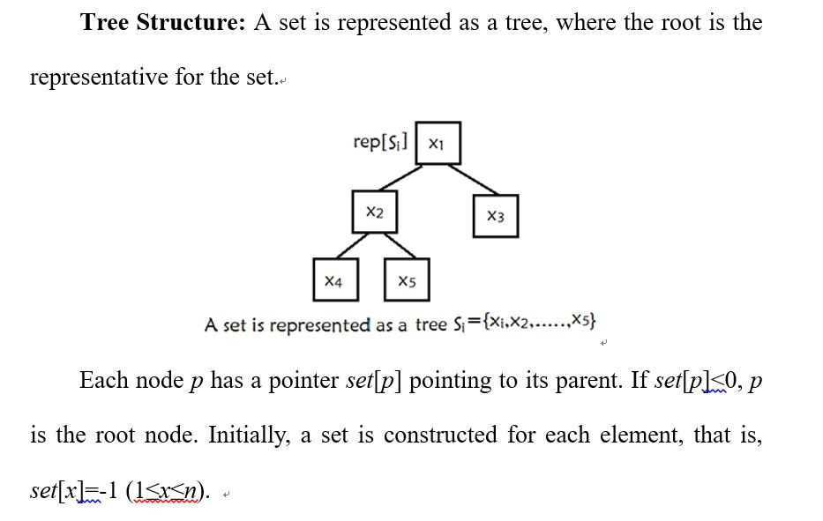

Slide 7
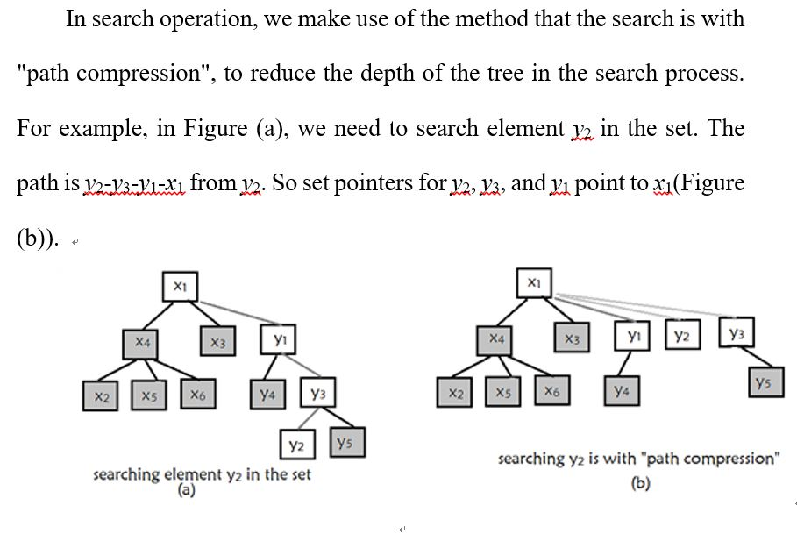

Slide 8
The algorithm that the search is with "path compression"
From node x, through set pointers the root of the tree f (set[f]<0) is found.
Set pointers for all nodes on the path from x to f point to f to compress the path.

Slide 9
The algorithm that the search is with "path compression"
int set_find(int p) // Search the representative of the set containing p, and compress the path
{
if (set[p]<0)
return p;
return set[p]=set_find(set[p]);
}

Slide 10
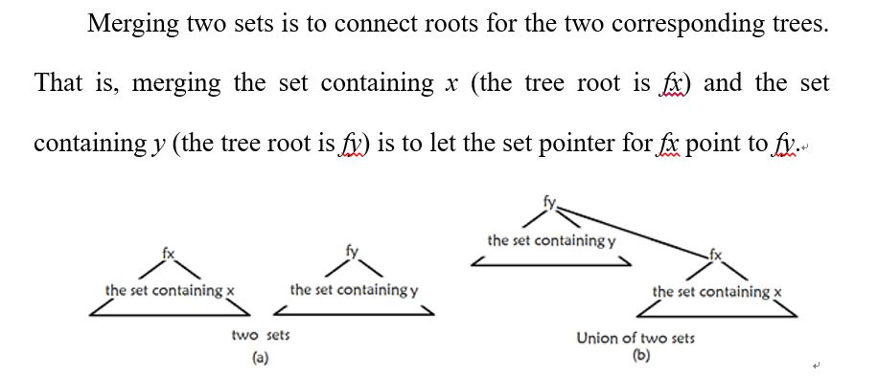

Slide 11
The merging algorithm
Calculate root fx in the tree for the union set containing x, and calculate root fy in the tree for the union-find set containing y.
If fx==fy, then x and y are in the same union-find set; else the set containing x is merged into the set containing y, that is, the set pointer for fx points to fy.

Slide 12
The merging algorithm
void join(int p, int q) // Merging the set containing p into the set containing q
{
p=set_find(p);
q=set_find(q);
if (p!=q)
set[p]=q;
}

Slide 13
Search with "path compression" can reduce the length of a tree and can improve the time complexity. In algorithm complexity, an union-find set represented as a tree is better than as a linear list.

Slide 14
Wireless Network
Source: POJ Monthly, HQM
IDs for Online Judge: POJ 2236

Slide 15
An earthquake takes place in Southeast Asia. The ACM (Asia Cooperated Medical team) have set up a wireless network with the lap computers, but an unexpected aftershock attacked, all computers in the network were all broken. The computers are repaired one by one, and the network gradually began to work again. Because of the hardware restricts, each computer can only directly communicate with the computers that are not farther than d meters from it. But every computer can be regarded as the intermediary of the communication between two other computers, that is to say computer A and computer B can communicate if computer A and computer B can communicate directly or there is a computer C that can communicate with both A and B.

Slide 16
In the process of repairing the network, workers can take two kinds of operations at every moment, repairing a computer, or testing if two computers can communicate. Your job is to answer all the testing operations.

Slide 17
Input
The first line contains two integers N and d (1≤N≤1001, 0≤d≤20000). Here N is the number of computers, which are numbered from 1 to N, and D is the maximum distance two computers can communicate directly. In the next N lines, each contains two integers x_{i}, y_{i} (0≤x_{i}, y_{i}≤10000), which is the coordinate of N computers. From the (N+1)-th line to the end of input, there are operations, which are carried out one by one. Each line contains an operation in one of following two formats:
1. "O p" (1≤p≤N), which means repairing computer p.
2. "S p q" (1≤p, q≤N), which means testing whether computer p and q can communicate.
The input will not exceed 300000 lines.
Output
For each Testing operation, print "SUCCESS" if the two computers can communicate, or "FAIL" if not.

Slide 18
Analysis
Working computers that can communicate constitute a set.
Suppose the representative of the set containing computer p is set[p]; the sign whether computer p works is valid[p]; function join(p, q) is used to merge the set containing p into the set containing q; and function set_find( p) is used to find the representative of the set containing p.

Slide 19
“O p” (1≤p≤N); Repairing computer p:
Computer p works (valid[p] = true); Find each working computer i that can communicate with computer p (valid[i] &&((x_{i}- x_{p})²+( y_{i}- y_{p})²)≤d², 1≤i≤n) and merge the set containing i into the set containing q( join(i, p)).
“S p q” (1≤p, q≤N); Testing whether computer p and q can communicate:
If computer p and computer q belong to a same set (set_find(p) == set_find(q)), then computer p and computer q can communicate; else they can’t.

Slide 20
Union-Find Sets used to determine graph connectivity
The partition for the set of vertices is based on edges in the graph. If two vertices are connected by an edge, they are in a same set.
each vertex in a graph constitutes a set.
input the edges in the graph. If the two vertices are associated with an edge, and are in two different sets, then the two sets should be merged.
Repeat the above process to get the partition of the set of vertices.
If all vertices are in a same set, the graph is connected; otherwise, the graph is not connected, and each partition for the set of vertices is a connected component of the graph.

Slide 21
Is It A Tree?
Source: ACM North Central North America 1997
IDs for Online Judge: POJ 1308，UVA 615

Slide 22
A tree is a well-known data structure that is either empty (null, void, nothing) or is a set of one or more nodes connected by directed edges between nodes satisfying the following properties.
There is exactly one node, called the root, to which no directed edges point.
Every node except the root has exactly one edge pointing to it.
There is a unique sequence of directed edges from the root to each node.
For example, consider the illustrations below, in which nodes are represented by circles and edges are represented by lines with arrowheads. The first two of these are trees, but the last is not.

Slide 23
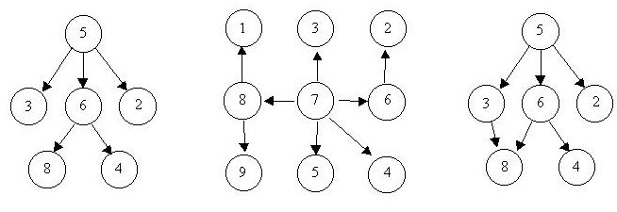

Slide 24
In this problem you will be given several descriptions of collections of nodes connected by directed edges. For each of these you are to determine if the collection satisfies the definition of a tree or not.

Slide 25
Input
The input will consist of a sequence of descriptions (test cases) followed by a pair of negative integers. Each test case will consist of a sequence of edge descriptions followed by a pair of zeroes Each edge description will consist of a pair of integers; the first integer identifies the node from which the edge begins, and the second integer identifies the node to which the edge is directed. Node numbers will always be greater than zero.
Output
For each test case display the line "Case k is a tree." or the line "Case k is not a tree.", where k corresponds to the test case number (they are sequentially numbered starting with 1).

Slide 26
Euler Graph
Definition (Euler Circuit, Euler graph).
A circuit in a graph G containing all edges is called an Euler circuit of G. And graph G is called Euler graph.

Slide 27
The algorithm implementation for the constructive proof of Euler graph
Theorem. Graph G is connected. Graph G is an Euler graph if and only if degrees for all vertices are even.
the proof for necessity is also the algorithm finding the Euler circuit.
a programming contest problem "the necklace“.
creating a graph model

Slide 28
Proof.
Suppose G has an Euler circuit x₁ x₂ … x_{m}, x₁= x_{m}. And x_{i} occurs k times in the sequence x₁ x₂ … x_{m}, 1≤i≤m-1. Then d(x_{i})=2k.
Therefore, each vertex has even degree.

Slide 29
Because G is connected and each vertex has even degree, there is a circuit C in G and the circuit C can be gotten by DFS.
If C isn’t the Euler circuit, in C there must be a vertex v_{k} whose degree is larger than the number of edges connected by v_{k} in C. From v_{k} a cuicuit C’ whose edges aren’t in C can be gotten through DFS.
If C∪C’=G, C∪C’is Euler circuit. Else by the same reason, in C∪C’ there must be a vertex v_{k}’ whose degree is larger than the number of edges connected by v_{k}’ in C∪C’. And from v_{k}’ a cuicuit C” whose edges aren’t in C∪C’ can be gotten through DFS. Then C” is added into C∪C’. And so on until the Euler circuit is gotten.■

Slide 30
The Necklace
Source: ACM Shanghai 2000，University of Valladolid New Millenium Contest
IDs for Online Judges: UVA 10054, UVA 2036

Slide 31

My little sister had a beautiful necklace made of colorful beads. Two successive beads in the necklace shared a common color at their meeting point. The figure below shows a segment of the necklace:

Slide 32
One day, the necklace was torn and the beads were all scattered over the floor. My sister did her best to recollect all the beads from the floor, but she is not sure whether she was able to collect all of them. Now, she has come to me for help. She wants to know whether it is possible to make a necklace using all the beads she has in the same way her original necklace was made and if so in which order the bids must be put.
Please help me write a program to solve the problem.

Slide 33
Input
The input contains T test cases. The first line of the input contains the integer T.
The first line of each test case contains an integer N (5≤N≤100) giving the number of beads my sister was able to collect. Each of the next N lines contains two integers describing the colors of a bead. Colors are represented by integers ranging from 1 to 50.

Slide 34
Output
For each test case in the input first output the test case number as shown in the sample output. Then if you apprehend that some beads may be lost just print the sentence ``some beads may be lost" on a line by itself. Otherwise, print N lines with a single bead description on each line. Each bead description consists of two integers giving the colors of its two ends. For 1≤i≤N-1, the second integer on line i must be the same as the first integer on line i + 1. Additionally, the second integer on line N must be equal to the first integer on line 1. Since there are many solutions, any one of them is acceptable.
Print a blank line between two successive test cases.

Slide 35
Analysis to the Experiment: Data Structure + Algorithm = Program
A graph model
In the graph, what are vertices (objects)? What are edges (relationships among objects)?
Beads == vertices, two beads is connected === an edges. === > The graph can’t represent the problem well.
Three beads (red | green), (red | white) and (red | red),
the circuit (green | red) (red | white) (red | red)
The graph can't represent objects and relationships among objects.

Slide 36
A graph G(V, E) is created.
Each color is represented as a vertex, V={ v₁, v₂, ……, v_{m} }.
Each bead is represented by an edge.
If there is a bead (c1, c2), there is an edge {v_{c1}, v_{c2}}.
whether a necklace can be made from collected beads === whether there is a Euler circuit in a graph.

Slide 37
The algorithm implementation for the constructive proof of Euler graph
Step 1: Graph G is constructed while test cases are input. degrees of all vertices are calculated. For two vertices of an edge, union-find sets containing the two vertices are merged.
Step 2: Search the root of the union-find set of each vertex: if two vertices belong to different union-find sets, graph G is not connected, and Euler circuit does not exist. Otherwise,
Step 3: If there is a vertex with odd degree, Euler circuit does not exist. Otherwise,
Step 4: DFS is used to search an Euler circuit.

